Slide 1
INTRODUCTION TO CRYPTOPGRAPHY
Lecture 2: Cryptography

Slide 2
Encryption
Encryption is a way of scrambling data so that only authorized parties can understand the information.
In technical terms, it is the process of converting human-readable plaintext to incomprehensible text, also known as ciphertext.
In simpler terms, encryption takes readable data and alters it so that it appears random.
Encryption requires the use of a cryptographic key: a set of mathematical values that both the sender and the recipient of an encrypted message agree on.
The recipient can use the agreed key to convert ciphertext to the original, meaningful text again.

Slide 3
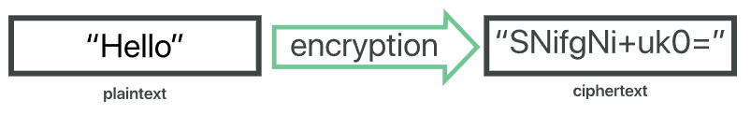
Encryption
Truly secure encryption will use keys complex enough that a third party is highly unlikely to decrypt or break the ciphertext by brute force — in other words, by guessing the key.
This makes the ciphertext useless to the attacker, preserving data confidentiality.
Data can be encrypted "at rest," when it is stored, or "in transit," while it is being transmitted somewhere else.

Slide 4
Problems Addressed by Encryption
Encryption may solve -
Confidentiality - An attacker will not be able to make any sense out of cipher text, which preserves the confidentiality of the data.
Integrity - Changing plaintext is easy. For example, an attacker can change “hello” to “goodbye”. But if all the attacker sees is “SNifgNi+uk0=”, he will have no idea what to change to get the corresponding ciphertext for “goodbye”. That takes away his chance of altering to an intended message.
Even if the attacker changes the cipher text from “SNifgNi+uk0=” to “SNifgNi+uZ0=”, or any other random change, the recipient will find a meaningless answer on decryption and will reject the message.

Slide 5
Encryption Terminology
Sender
Recipient
Transmission medium - the internet
Interceptor/intruder
Encrypt, encode, or encipher
Decrypt, decode, or decipher
Cryptosystem - A system for encryption and decryption
Plaintext - Original text
Ciphertext - Encrypted text

Slide 6
Encryption: example
Imagine Caesar wants to send this message:
SECRET MEETING AT THE PALACE
Here's what that might look like encrypted:
YKIXKZ SKKZOTM GZ ZNK VGRGIK
That looks an awfully lot like gobbledygook at first, but this encrypted message is actually very related to the original text.
The Caesar Cipher is a simple substitution cipher which replaces each original letter with a different letter in the alphabet by shifting the alphabet by a certain amount.

Slide 7
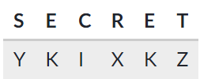
Encryption: example
To make the encrypted message above, I shifted the alphabet by 6 and used this substitution table:
S shifts 6 letters over to Y, E shifts 6 letters over to K, etc. Here's the first word and its shifts:

Slide 8
Encryption: example
Now imagine Caesar wants to send the following message, with the same shift of 6:
ALEXANDRIA SOON
Can you work out the encrypted message?

Slide 9
Decryption: example
According to historical records, Caesar always used a shift of 3. As long as his message recipient knew the shift amount, it was trivial for them to decode the message.
Imagine Caesar sends this message to a comrade:
EHZDUH EUXWXV
The comrade uses this substitution table, where the alphabet is shifted by 3:
Can you find the decrypted message?

Slide 10
Decryption: example
Imagine that a very literate and savvy enemy intercepts one of Caesar's messages.
RZ VMZ WMDIBDIB VGG AJMXZN OJ EJDI RDOC XGZJKVOMV OJ YZAZVO OCZ ZIZHT LPZZI VO OCZ IDGZ YZGOV
That enemy does not know that Caesar always uses a shift of 3, so he must attempt to "crack" the cipher without knowing the shift.
There are three main techniques he could use: frequency analysis, known plaintext, and brute force.

Slide 11
Frequency analysis
Human languages tend to use some letters more than others. For example, "E" is the most popular letter in the English language. We can analyze the frequency of the characters in the message and identify the most likely "E" and narrow down the possible shift amounts based on that.
Try it out yourself! Use this tool to analyze the frequency graph to identify a possible "E"
Can you crack the cipher?

Slide 12
Known plain text
Another term for the original unencrypted message is plaintext. If the enemy already knew some part of the plaintext, it will be easier for them to crack the rest of the encrypted version.
For example, messages tend to start with similar beginnings. In WWII, encrypted German messages always started with a weather forecast, which ultimately made them easier for British mathematician Alan Turing to crack.
Do you think Julius started this message in a common way?

Slide 13
Brute force
There are only 25 possible shifts (not 26 — why not?).
The enemy could take some time to try out each of them and find one that yielded a sensible message.
They wouldn't even need to try the shifts on the entire message, just the first word or two.
Try to brute force the cipher with this tool.
Caesar's enemy wouldn't have a computer to help them, but it likely would take them less than an hour if they understood the idea of the Caesar Cipher.
Hence Caesar cipher is no longer secure. Modern encryption algorithms are much, much more complicated.

Slide 14
Key
Modern encryption algorithm use a key.
A cryptographic key is a string of characters used within an encryption algorithm for altering data so that it appears random.
Like a physical key, it locks (encrypts) data so that only someone with the right key can unlock (decrypt) it.
The same plain text can produce different cipher texts if different keys are used.
Hence, to decrypt cipher text to plain text, it is necessary to know the key.
Those who don’t know the key (like an attacker) can not decrypt the ciphertext (provided the used cryptosystem is secure enough).

Slide 15
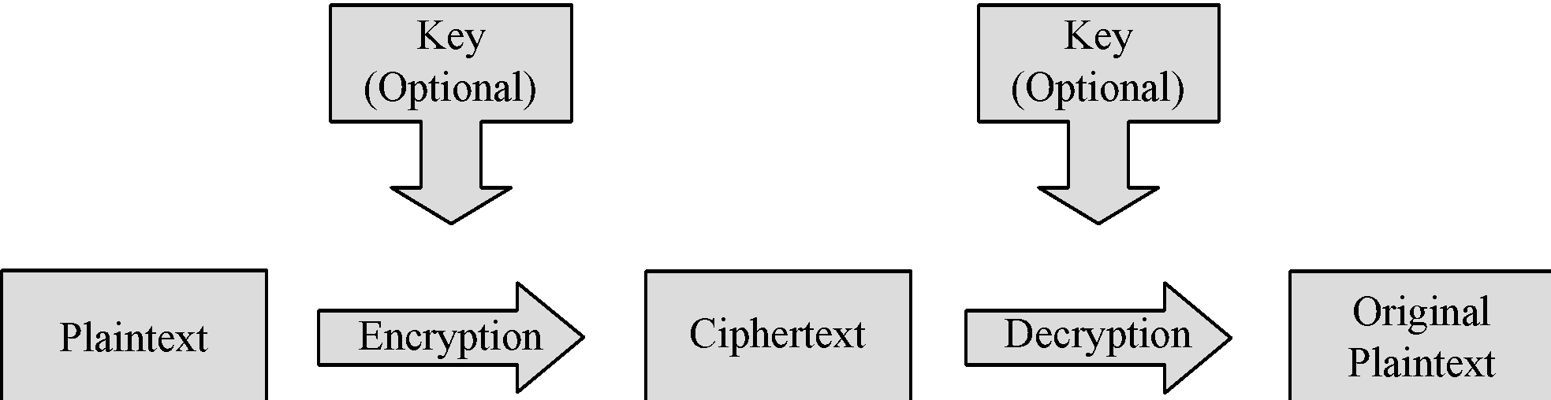
Encryption/Decryption Process
Notes:
The basic process of encrypting and then decrypting data.

Slide 16
Types of encryption
The two main kinds of encryption are symmetric encryption and asymmetric encryption (or public key encryption).
In symmetric encryption, there is only one key, and all communicating parties use the same (secret) key for both encryption and decryption.
In asymmetric, or public key, encryption, there are two keys: one key is used for encryption, and a different key is used for decryption.
The decryption key is kept private (hence the "private key" name), while the encryption key is shared publicly, for anyone to use (hence the "public key" name).
Asymmetric encryption is a foundational technology for TLS (often called SSL).

Slide 17
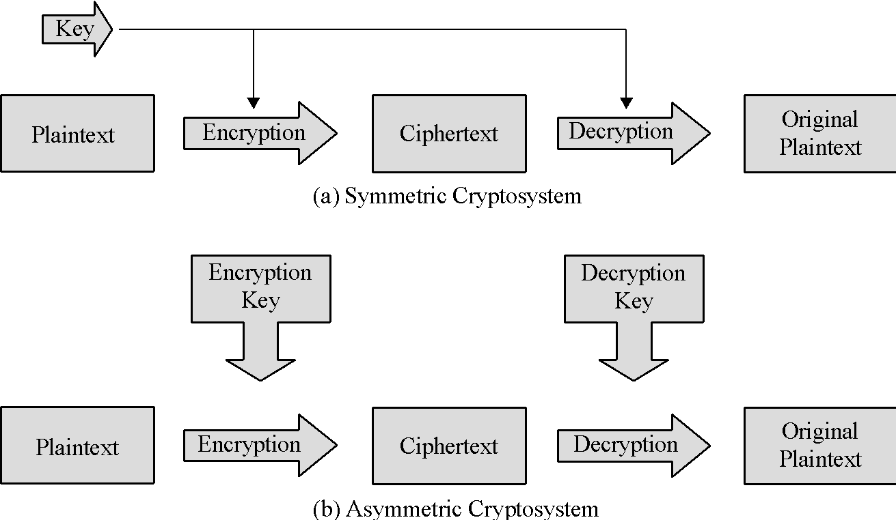
Symmetric vs. Asymmetric
Notes:
The critical difference between symmetric and asymmetric is that symmetric uses a single key for both encryption and decryption, whereas asymmetric uses complementary keys.

Slide 18
Encryption algorithms
Some common algorithms:
Symmetric encryption: Twofish, AES, Blowfish, DES
Asymmetric encryption: RSA, DSA, ECC

Slide 19
SSL
A major use of encryption is in SSL.
SSL, or Secure Sockets Layer, is an encryption-based Internet security protocol.
It was first developed by Netscape in 1995 for the purpose of ensuring privacy, authentication, and data integrity in Internet communications.
SSL is the predecessor to the modern TLS encryption used today.
A website that implements SSL/TLS has "HTTPS" in its URL instead of "HTTP."

Slide 20
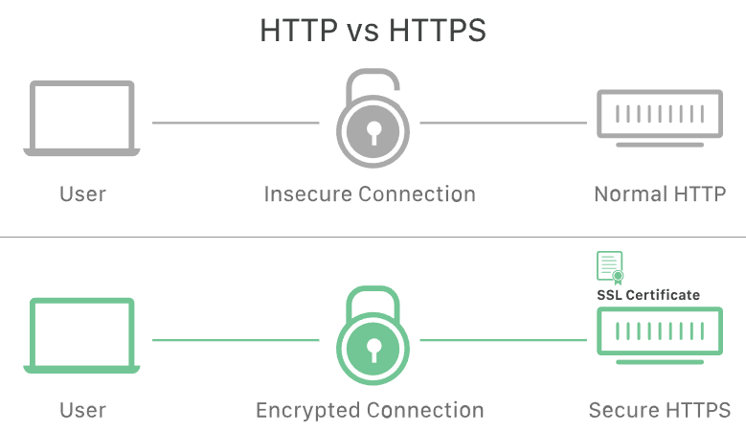
SSL

Slide 21
SSL
Originally, data on the Web was transmitted in plaintext that anyone could read if they intercepted the message.
For example, if a consumer visited a shopping website, placed an order, and entered their credit card number on the website, that credit card number would travel across the Internet unconcealed.
SSL was created to correct this problem and protect user privacy.
By encrypting any data that goes between a user and a web server, SSL ensures that anyone who intercepts the data can only see a scrambled mess of characters.
The consumer's credit card number is now safe, only visible to the shopping website where they entered it.

Slide 22
SSL
SSL can only be implemented by websites that have an SSL certificate (technically a "TLS certificate").
An SSL certificate is like an ID card or a badge that proves someone is who they say they are.
SSL certificates are stored and displayed on the Web by a website's or application's server.
One of the most important pieces of information in an SSL certificate is the website's public key.
The public key makes encryption possible.
A user's device views the public key and uses it to establish secure encryption keys with the web server.
Meanwhile the web server also has a private key that is kept secret; the private key decrypts data encrypted with the public key.
Certificate authorities (CA) are responsible for issuing SSL certificates.

Slide 23
SSL
Certificate authorities (CA) are responsible for issuing SSL certificates.
Hence, if a website uses a fake SSL certificate, it will not be signed by a CA, which the browser will warn the user about.
This way SSL also stops certain kinds of cyber attacks: It authenticates web servers, which is important because attackers will often try to set up fake websites to trick users and steal data.
It also prevents attackers from tampering with data in transit, like a tamper-proof seal on a medicine container.
Tampering with data in transit breaks the “seal” and makes the data useless.

Slide 24


SSL
Compare these two security indicators in my version of Google Chrome. The site on the left is not using TLS, while the site on the right is.
HTTPS stands for HyperText Transfer Protocol Secure, but is often called HTTP over SSL.

